Slide 1

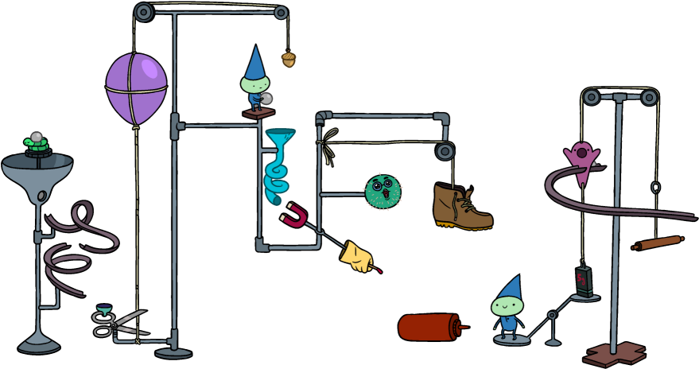
Rube Goldberg Team
Midpoint Presentation
Summer 2019
Jassem Alhaddad - Team Leader
Ali Alrashidi - Web Developer
Omar Aldhafeeri - Client Contact
Ali Almari - Documents
Mohammed Albanaqi - Budget
Abdullah Alsayeh - Equipment
Jassem Alhaddad

Slide 2
Overview
Project Description
Black Box Model
Functional Model
Designs Considered
Design Selected
Decision Matrix
Customer Requirements
Budget
Gantt Chart
References
Jassem Alhaddad

Slide 3
Project Description
Rube Goldberg is a machine that performs a very simple task in a very complex fashion, usually including a chain reaction.
The objective is to create a reliable and resettable machine of Rube Goldberg steps.
Jassem Alhaddad

Slide 4
Project Description
Clients:
Dr. Trevas
Sponsor:
Mechanical Engineering Department
Why is sponsorship important?
The most powerful marketing tool.
Give your target audience a support.
Help you meet your goals.
“ Cont’d ”
Jassem Alhaddad

Slide 5
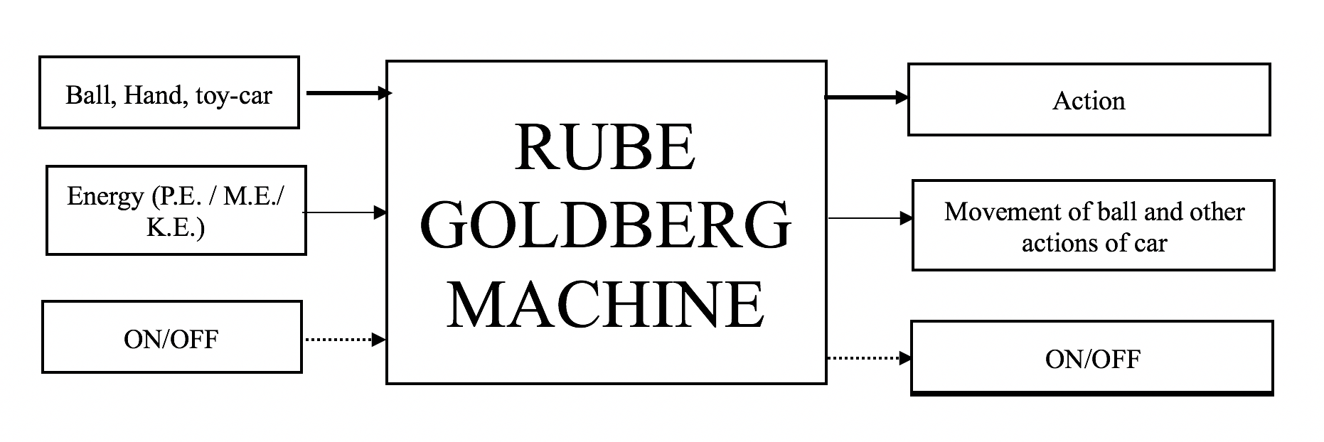
Black Box Model
Ali Almari

Slide 6
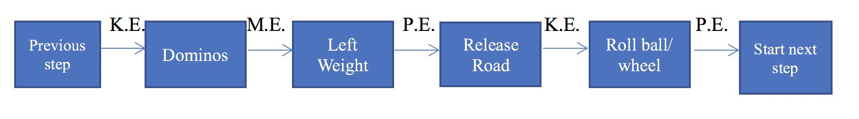
Functional Model
Ali Almari

Slide 7
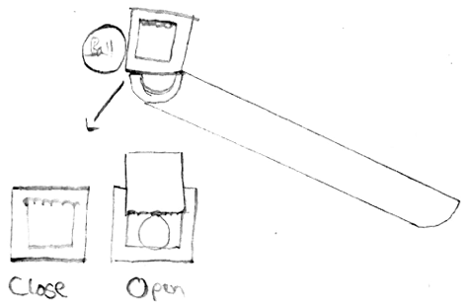
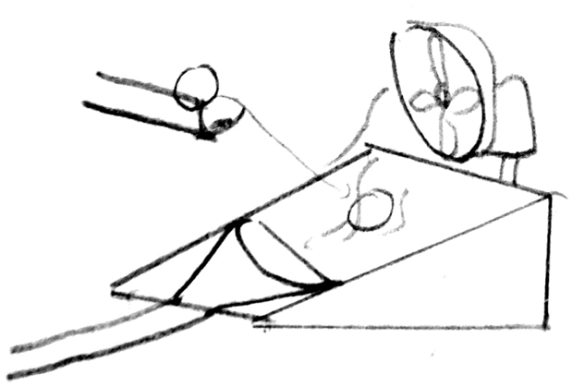
Designs Considered
Figure 1
Advantages:
Simplicity
Easy to Calculate
Disadvantages:
Space
Figure 2
Advantages:
Robust
Size
Disadvantages:
Timing
Risk not working
Figure 1: Ramp
Figure 2: Fluid Mechanics by a Fan
Ali Alrashidi

Slide 8
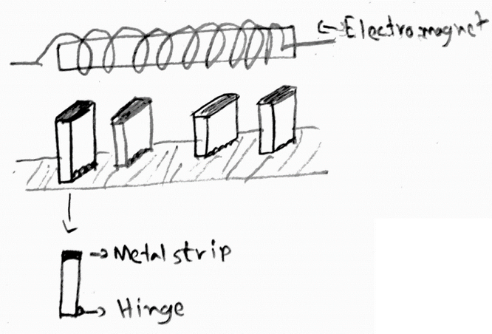
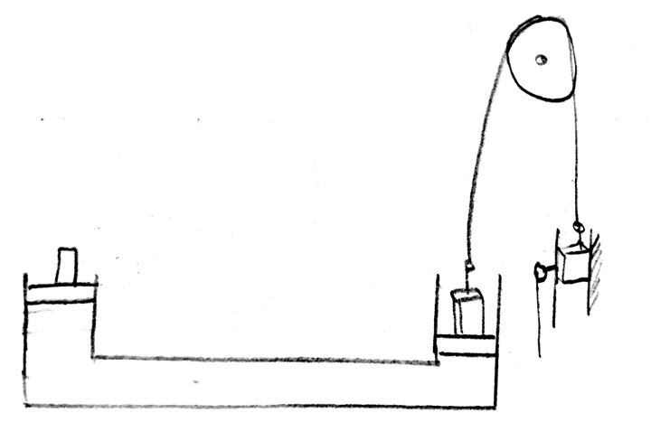
Designs Considered
Figure 3
Advantages:
Resettable
Creative
Disadvantages:
Cost
Building it
Figure 4
Advantages:
Durability
Resettable
Disadvantages:
Robust
Cost
Figure 3: Electromagnetic & Magnet
Figure 4: Pascal fluid mechanics
Ali Alrashidi

Slide 9
How this design meets the Customer Requirements?
Factors:
Cost
Safety
Realistic
Size
Resettable
Timing
Limitations:
Animals
Flammable
Noise
10 * 10 ft^2
Abdullah Alsayeh

Slide 10
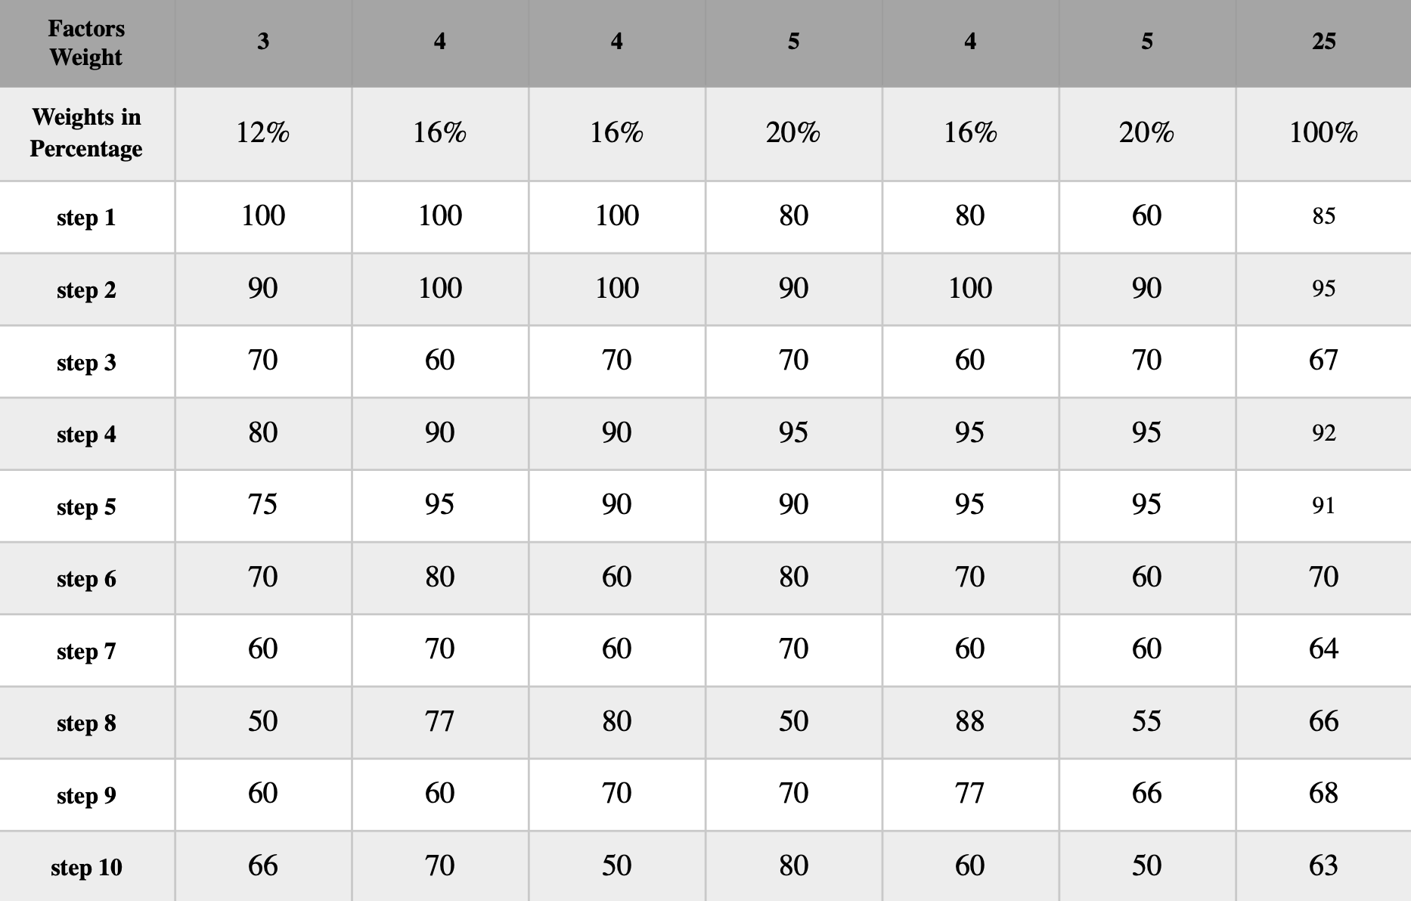
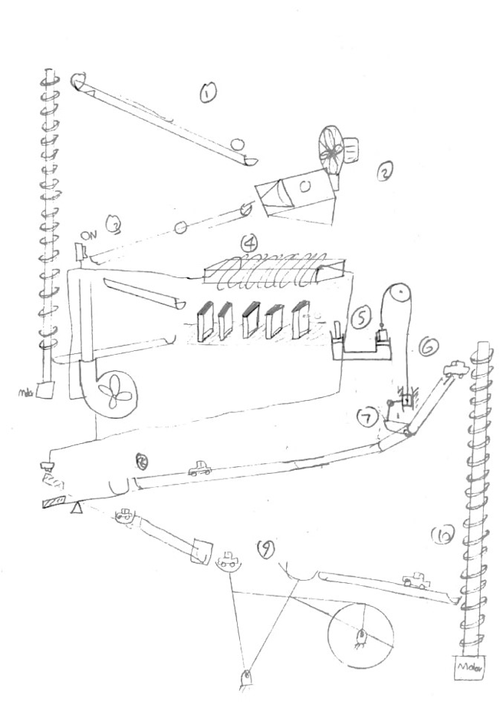
Decision Matrix & Design Selected
Cost
Realistic
Size
Safety
Timing
Resettable
Abdullah Alsayeh

Slide 11
Budget
Expense Details | Cost
Total Budget | $1400
Anticipated Expenses | $1000
Actual Expenses | $129
Resulting Balance | $1271
We are currently on schedule
Mohammed Albanaqi

Slide 12
Budget
Items | Quantity | Cost | Reference
Wild wire | 2 | $14 | Home depot
White peg board | 1 | $22 | Home depot
Balls | 10 | $6 | Walmart
Fan | 1 | $15 | Walmart
Light switch | 1 | $9 | Walmart
Way paddle switch | 1 | $3 | Walmart
Light control | 1 | $6 | Walmart
Flex funnel | 1 | $6 | Autozone
Softwood board | 1 | $48 | Home Depot
“ Cont’d ”
Total
$129
Mohammed Albanaqi

Slide 13
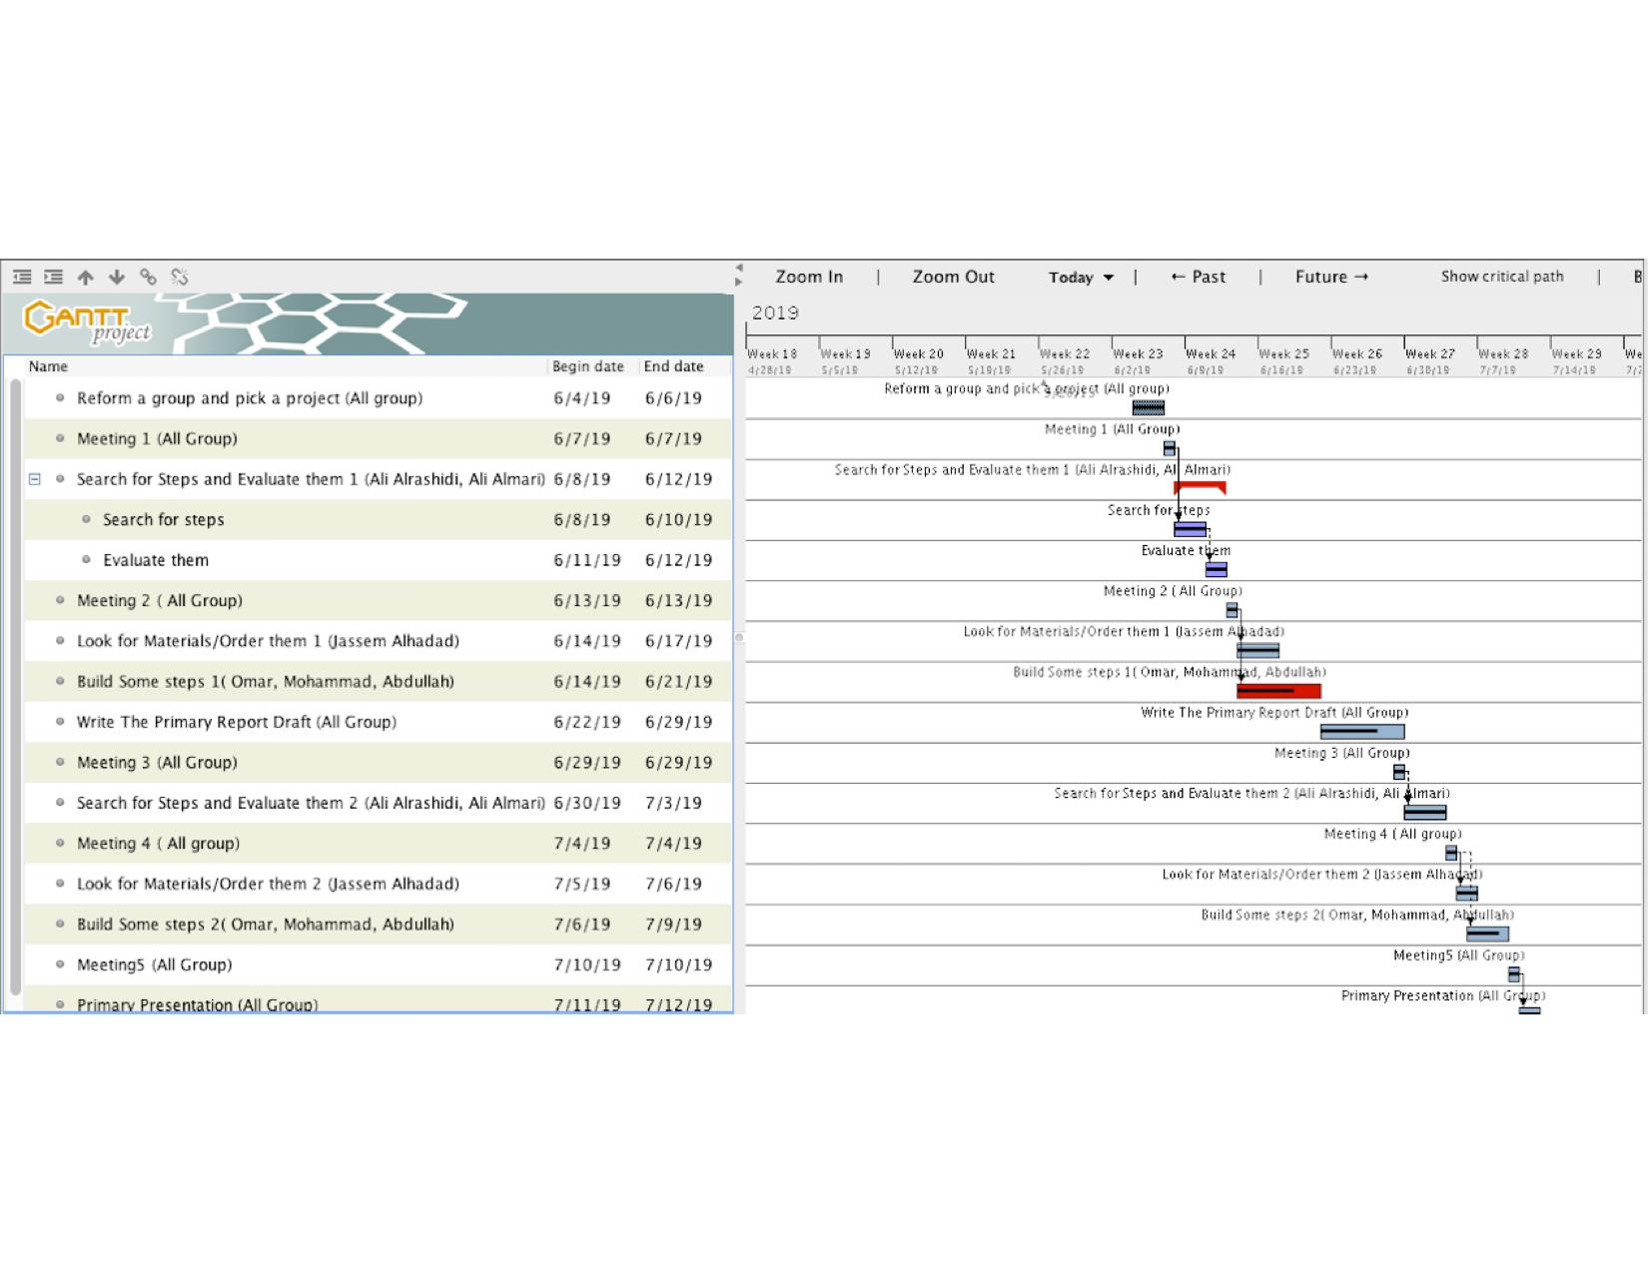
Gantt Chart
Gantt Chart:
Omar Aldhafeeri

Slide 14
References
[1]BarD Software s.r.o, “Build - GanttProject Docs,” Ganttproject.biz, 2018. [Online].
https://docs.ganttproject.biz/development/build/
‌
[2]“Rube Goldberg – Home of the Official Rube Goldberg Machine Contests.” Rubegoldberg.Com, 2018, www.rubegoldberg.com/. Accessed 11 July 2019.
[3]Nau.Edu,2019,nau.edu/visual-identity-guide/wp-content/uploads/sites/121/2018/09/NAU_Acronym_Horiz_1Line-281_3514-1024x50.png. Accessed 11 July 2019.
Build native PowerPoint timelines online. (n.d.). Retrieved from https://online.officetimeline.com/app/#/file/6399a039-18ea-4125-a30c-e2b765eb7412/gantt-view.
‌

Slide 15
Questions?

